Slide 1
Research in Development Economics: Using IV Regressions in Empirical Work Dr. Kamiljon T. Akramov IFPRI, Washington, DC, USA
Training Course on Applied Econometric Analysis
September 13-23, 2016, WIUT, Tashkent, Uzbekistan

Slide 2
Outline
Review of IV estimation
Example 1: Institutions and growth
Example 2: Foreign aid and growth

Slide 3
Principles of IV estimation
Assume that we have an equation that can be written as follows:
$Y_{i}=β_{1}X_{i}+ε_{i}$
However, the equation suffers from endogeniety bias; accordingly, estimating this equation employing OLS will not yield an accurate estimate of the causal effect of interest
Let us denote the true coefficient of interest $θ_{0}$, while $β_{1}$ denotes the estimated coefficient in the OLS specification

Slide 4
Principles of IV estimation (cont.)
Now, let us assume that we have another measured variable, $Z_{i}$, that is correlated with $X_{i}$ but uncorrelated with $ε_{i}$, i.e.,
$Cov\left(Z_{i},ε_{i}\right)=0$
The coefficient of interest can be written as follows
$θ_{0}=\frac{Cov(Y_{i},Z_{i})}{Cov(X_{i},Z_{i})}$
Note that this expression is only valid if the covariance of the instrument and the independent variable is different from zero
In practice, instrumental variables estimates are not particularly useful if $Cov(X_{i},Z_{i})$is only marginally different from zero

Slide 5
IV conditions
First, there must be a significant relationship between the instrument $Z_{i}$ and the explanatory variable $X_{i}$, i.e,$Corr(Z_{i},X_{i})≠0$
This condition is called instrument relevance
Second, the instrument must satisfy an exclusion restriction: the only reason for the relationship between $Y_{i}$ and $Z_{i}$ is the first stage
This assumption has two parts
The instrument is as good as randomly assigned (i.e., independent of potential outcomes, conditional on covariates)
The instrument has no effect on outcomes other than via the first-stage channel

Slide 6
The IV Estimator
Two stage least squares has two stages – two regressions
In the first stage it isolates the part of X that is uncorrelated with u by regressing X on Z using OLS
X_{i} = π₀ + π₁Z_{i} + v_{i}
Compute predicted values of $X_{i}$( ) using this regression results
In the second stage regress $Y_{i}$ on using OLS
The resulting estimator is called the TSLS estimator,

Slide 7
Identification
In IV regression, whether the coefficients are identified depends on the relation between the number of instruments (m) and the number of endogenous regressors (k)
Intuitively, if there are fewer instruments than endogenous regressors, we can’t estimate β₁,…,β_{k}
The coefficients β₁,…,β_{k} are said to be:
exactly identified if m = k
overidentified if m > k
underidentified if m < k

Slide 8
Checking Instrument Validity: Relevance
First stage regression
X_{i} = π₀ + π₁Z_{1i} +…+ π_{mi}Z_{mi} + π_{m+1i}W_{1i} +…+ π_{m+ki}W_{ki} + u_{i}
The instruments are relevant if at least one of π₁,…,π_{m} are nonzero
The instruments are said to be weak if all the π₁,…,π_{m} are either zero or nearly zero
Weak instruments explain very little of the variation in X, beyond that explained by the W’s
If instruments are weak, the usual methods of inference are unreliable – potentially very unreliable

Slide 9
Measuring Instrument Strength in Practice: The first-stage F-statistic
The first stage regression (one X): regress X on Z₁,..,Z_{m},W₁,…,W_{k}
Totally irrelevant instruments: all the coefficients on Z₁,…,Z_{m} are zero
The first-stage F-statistic tests the strength of instruments in the first stage regression
Rule-of-thumb: If the first stage F-statistic is less than 10, then the set of instruments is weak
Weak instruments imply a small first stage F-statistic
If so, the TSLS estimator will be biased, and statistical inferences (standard errors, hypothesis tests, confidence intervals) can be misleading

Slide 10
What to Do If You Have Weak Instruments?
Find better instruments
If there are many instruments, some are probably weaker than others and it’s a good idea to drop the weaker ones (dropping an irrelevant instrument will increase the first-stage F)
Use a different IV estimator instead of TSLS
There are many IV estimators available when the coefficients are overidentified
Limited information maximum likelihood (LIML) has been found to be less vulnerable to weak instruments

Slide 11
Checking Instrument Validity: Exogeniety
Instrument exogeneity: All the instruments are uncorrelated with the error term: corr(Z_{1i},u_{i}) = 0,…, corr(Z_{mi},u_{i}) = 0
If the instruments aren’t correlated with the error term, the first stage of TSLS doesn’t successfully isolate a component of X that is uncorrelated with the error term, so is correlated with u and TSLS is inconsistent
If there are more instruments than endogenous regressors, it is possible to test – partially – for instrument exogeneity

Slide 12
Testing overidentifying restrictions
Suppose there is one endogenous regressor and there are two valid instruments: Z_{1i}, Z_{2i}
Then we could compute two separate TSLS estimates
Intuitively, if these 2 TSLS estimates are very different from each other, then something must be wrong: one or the other (or both) of the instruments must be invalid
The J-test of overidentifying restrictions makes this comparison in a statistically precise way if number of Z’s > number of X’s (overidentified)

Slide 13
The J-test of Overidentifying Restrictions
First estimate the equation of interest using TSLS and all m instruments
Compute the predicted values , using the actual X’s
Compute residuals and
Regress against Z_{1i},…,Z_{mi}, W_{1i},…,W_{ri}
Compute the F-statistic testing the hypothesis that the coefficients on Z_{1i},…,Z_{mi} are all zero
The J-statistic is J = mF, where F = the F-statistic testing the coefficients on Z_{1i},…,Z_{mi} in a regression of the TSLS residuals against Z_{1i},…,Z_{mi}, W_{1i},…,W_{ri}

Slide 14
The J-test of Overidentifying Restrictions (cont.)
Under the null hypothesis that all the instruments are exogenous, J has a chi-squared distribution with m–k degrees of freedom
If m = k, J = 0
If some instruments are exogenous and others are endogenous, the J statistic will be large, and the null hypothesis that all instruments are exogenous will be rejected

Slide 15
How to find valid instruments
Valid instruments are (1) relevant and (2) exogenous
One general way to find instruments is to look for exogenous variation – variation that is “as if” randomly assigned in a randomized experiment – that affects X
Rainfall shifts the supply curve for butter but not the demand curve; rainfall is “as if” randomly assigned
Sales tax shifts the supply curve for cigarettes but not the demand curve; sales taxes are “as if” randomly assigned

Slide 16
Example 1: Colonial Origins of Comparative Development by Acemoglu et al. (2001)
The paper starts with the fundamental question: what is the fundamental cause of large differences in income per capita across countries?
Given that one plausible hypothesis is that differences in institutions and property rights lead to differences in income, how can this hypothesis be tested?
The objective of the paper is to identify the impact of institutions on economic performance, and accordingly, they need a source of exogenous variation in institutions
In other words, they need an instrument: a variable correlated with institutions, but otherwise uncorrelated with economic performance

Slide 17
Overview of identification strategy
European powers set up different types of institutions under colonialism:
some highly extractive,
some with greater emphasis on protections against expropriation and misuse of power
The type of institution chosen was influenced by the feasibility of settlement: if settler mortality was lower, there was a higher probability of better-quality institutions
Better-quality institutions persist, and lead to higher economic performance in the present day
Key insight: use settler mortality as an instrument for institutions

Slide 18
Reduced form relationship in a graph

Slide 19
Empirical specification
The primary equation of interest is the following
$logy_{i}=μ+αR_{i}+γX_{i}^{′}+ε_{i}$
where y denotes per-capita income, R is a measure of current institutions (protection against expropriation between 1985 and 1995), and X is other covariates
Additional variables of interest: C is a measure of early (circa 1900) institutions, S is a measure of European settlements (fraction of population with European descent in 1900), and M is mortality rates

Slide 20
Sources of bias in OLS regression
What direction of bias would we expect in the OLS results?
First, there may be measurement error in how we measure institutional quality
What direction of bias will this generate?
Second, institutions are endogenously determined
What direction of bias will this generate?

Slide 21
Discussion questions: identification
What direction of bias would measurement error and endogeneity, respectively, generate?
Which appears to dominate?
Do you find the identification strategy plausible?
What are potential sources of bias?
What can we observe about the strength of the first stage?

Slide 22
Discussion questions: interpretation
This was a “rock star" paper, providing seemingly rigorous evidence of a relationship between income and institutions
Is this result useful?
Are there policy implications?
How do we interpret “protection from expropriation"?
Do you think this is the primary, or only, dimension of institutions that matters?

Slide 23
Scholarly debate
The paper has been the center of an ongoing scholarly debate initiated by David Albouy from the University of Michigan
Albouy argued that there were significant challenges with the settler mortality data
Particularly, in a number of cases mortality rates for countries were not based on data collected within their borders, but rather imputed from countries with similar disease environments
When adjustments to the mortality rate are made, the first stage has very limited predictive power (low F-statistic)
The debate about the validity of AJR's empirical results continued!
AJR's response

Slide 24
Example 2: Foreign aid and economic growth (Akramov 2012)
One of the most enduring policy debates in development economics has to do with whether foreign aid helps recipients grow
Why is this important problem?
Donor countries transfer billions of US$ in official development assistance (ODA) to recipient countries
In 2014 donors provided a total of 131.6 billion US$ in net ODA

Slide 25
What is ODA?
The Development Assistance Committee (DAC) defines ODA as those flows to developing and transition countries, which are:
Provided by official or executive agencies of donor nations
Administered with the promotion of the economic development and welfare of developing nations as its main objective
Concessional in character and conveys a grant element of at least 25%, calculated at a discount rate of 10%
Developmentally relevant military, peacekeeping, nuclear energy, and culture related official assistance can be included in ODA

Slide 26
Past studies on aid-growth relationship
There is broad but contradictory literature on the aid-growth linkages
Three competing strands
Aid has no effect on growth and may sometimes even undermine growth in recipient countries (Mosley et al. 1987 & 1992, Boone 1994, Rajan and Subramanian 2008, etc.)
Aid in all likelihood positively influences economic growth, but with diminishing returns (Hansen and Tarp 2000 and 2001, Dalgaard et al. 2004, Arndt et al. 2010)
Aid has a conditional positive impact on growth (Burnside and Dollar 2000 and 2004)
Strong impact on donor policy
Easterley, Levine, and Roodman (2004) critique

Slide 27
This study
Disaggregates aid into sectoral aid flows using OECD DAC classification and then estimates the impact of sectoral aid flows on economic growth
Examines whether the interaction of foreign aid with the quality of governance is important for aid effectiveness
Applies IV methodology by improving on and extending the most recent instrumentation strategy used in the aid effectiveness literature

Slide 28
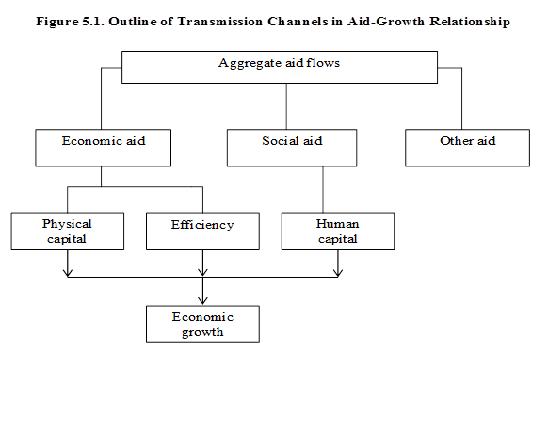
Analytical framework

Slide 29
Hypotheses
Economic aid, which includes aid to production sectors and aid to economic infrastructure, affects economic growth by increasing domestic investment
Supplement to domestic resources
Substitute to domestic resources
Crowding out effect and fungibility issues
Possible values of coefficient: 1, <1, or>1
Aid to economic infrastructure might affect growth by improving TFP
Aid to social sector may affect growth by creating additional human capital

Slide 30
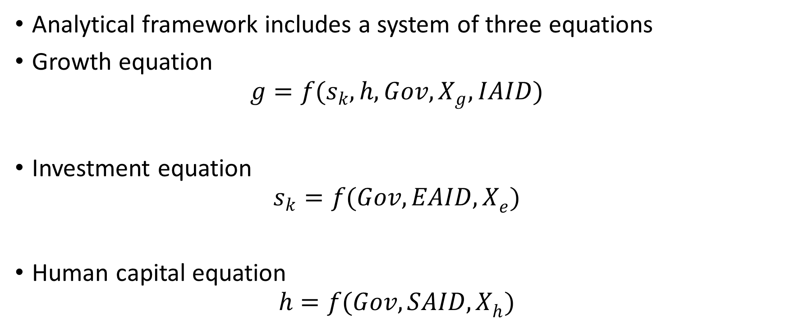
Model specifications
Analytical framework includes a system of three equations
Growth equation
$$g=f(s_{k}, h, Gov, X_{g}, IAID)$$
Investment equation
$$s_{k}=f(Gov, {EAID, X}_{e})$$
Human capital equation
$$h=f(Gov, {SAID, X}_{h})$$

Slide 31
Econometric estimation issues and identification
Pooled cross-section and/or panel data regression methods
Pooled cross-section regressions allow to examine the long-run relationship
We can’t rely on standard OLS because relationship between aid and growth (or income) is endogenous
If countries tend to receive more aid because they are poorer or their socioeconomic conditions are deteriorating, the estimated coefficient would be biased toward zero and underestimate the impact of foreign aid
If countries tend to receive less aid as their socioeconomic conditions improve, the estimated coefficient would be biased upward and overestimate the impact of aid

Slide 32
Econometric estimation issues and identification (cont.)
The quality of governance is endogenous with respect to development
If explanatory variables are systematically measured with significant error, the unobserved error term in the relationship of interest will contain the measurement error and it will be correlated with independent variables
One solution to deal with above mentioned issues is IV approach

Slide 33
Econometric estimation issues and identification (cont.)
Simultaneity bias due to joint determination of some variables in the analytical framework
Possible solution
Simultaneous system of equations method using 3SLS estimator

Slide 34
Econometric estimation issues and identification (cont.)
Unobserved heterogeneity due to country-specific time invariant unobservable factors and temporal events
Solution: Panel data estimation methods, which allows to control for country fixed effects and time fixed effects
It is assumed that unobserved error term has a factor structure, including country-specific time-invariant component, time-specific country-invariant component, and zero-mean random component
$γ_{jt}=η_{j}$+$μ_{t}+ν_{jt}$

Slide 35
Econometric estimation issues and identification (cont.)
Outliers
Solution: robust standard errors using the Huber-White sandwich estimator
Residual may include time-varying country-specific factors that affect the dependent variable
Possible existence of autocorrelation within panels
Possible existence of heteroskedasticity across panels (cross-sectional correlations)
Solution: Panel GMM regressions
Difference GMM estimator (Arrelano and Bond 1991)
System GMM estimator (Blundell and Bond 1998)

Slide 36
Results
Cross-section OLS regressions
Instrumentation strategy
Instrument for aid
Instrument for governance (democracy)
Cross-section IV regressions
System of simultaneous equations
Panel regressions

Slide 37
Instrument for aid
Complicated instrumentation strategy by Rajan and Subramanian (2008)
Bazzi and Clemens (2009) critique
Instrument for aid in this study
As in Rajan and Subramanian (2008)
Historical relationships are captured through past colonial links and commonality of languages
Influence is captured by the ratio of donor population to the recipient population
Relational effects between history and influence factors: interactions between relative size and colonial links, between relative size and language traits

Slide 38
Instrument for aid: modifications & extensions
Drop colonizer-specific variables and their interactions except the dummy for Portuguese colonies
Include donor-specific fixed effects
Controls for donor political and strategic interests (similarity of UN voting patterns)
Relational effects between recipient size and donor political interests (interactions)

Slide 39
Instrument for aid: modifications & extensions (cont.)
Donor commercial (trade promotion) interests ( for economic aid)
Relational effects between donor size and commercial interests
Controls to differentiate between types of sectoral aid flows
Initial (early 1970s) values of life expectancy, fertility, access to drinking water, ratio of physicians to the population, share of agriculture in GDP, and share of rural population

Slide 40
Instrument for governance (democracy)
The level of constraints on the executive in 1900, coded from the Polity IV database
It refers to the extent of institutional constraints on the decisionmaking powers of the executive branch

Slide 41
Main results
Use pdf file with regression results

Slide 42
Data and empirical analysis
Please use provided dataset and Stata do files

Slide 43
Discussion questions: identification
Do you find the identification strategy plausible?
What can we observe about the strength of the first stage?
Instrument relevance
Instrument exogeneity
What are potential problems?

Slide 44
Discussion questions: interpretation
Are these results useful?
Are there policy implications?

