Slide 1
Quantitative data analysis
Dr. Muzaffar Ahunov

Slide 2
/Numeric
/ Nominal
/ Ordinal
/Interval
/Ratio
Saunders et al (2003, p. 330)

Slide 3
Univariate analysis
Analysis of descriptive statistics

Slide 4
Frequency table showing reasons for visiting the gym
Reason | n | %
Relaxation | 9 | 10
Maintain or improve fitness | 31 | 34
Lose weight | 33 | 37
Build strength | 17 | 19
TOTAL | 90 | 100

Slide 5
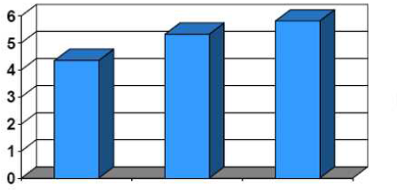

Slide 6
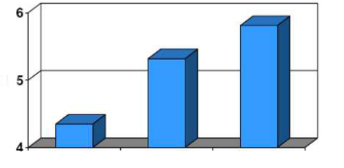

Slide 8
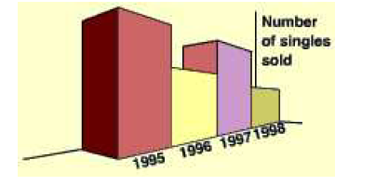

Slide 9
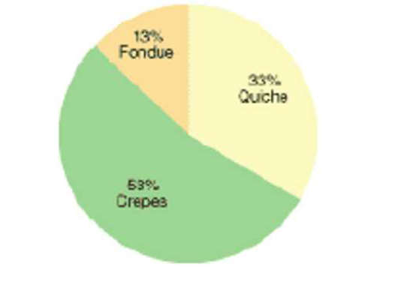

Slide 10
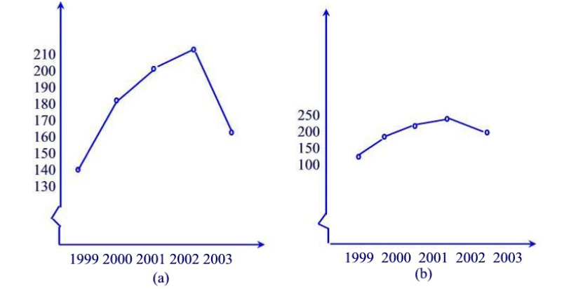

Slide 11
Methods of bivariate analysis
 | Nominal | Ordinal | Interval/Ratio | Dichotomous
Nominal | Contingency table+ Chi-square (X²) NP+ Cramér’s V | Contingency table+ Chi-square (X²) NP + Cramér’s V | Contingency table+ Chi-square (X²) NP+ Cramér’s V | Contingency table+ Chi-square (X²) NP+ Cramér’s V
Ordinal | Contingency table+ Chi-square (X²) NP + Cramér’s V | Spearman’s rho (ρ) NP | Spearman’s rho (ρ) NP | Spearman’s rho (ρ) NP
Interval/Ration | Contingency table+ Chi-square (X²) NP+ Cramér’s V | Spearman’s rho (ρ) NP | Pearson’s r P | Spearman’s rho (ρ) NP
Dichotomous | Contingency table+ Chi-square (X²) NP+ Cramér’s V | Spearman’s rho (ρ) NP | Spearman’s rho (ρ) NP | Phi (φ)

