Slide 1
Research in Development Economics: Natural Experiments Dr. Kamiljon T. Akramov IFPRI, Washington, DC, USA
Regional Training Course on Applied Econometric Analysis
June 12-23, 2017, WIUT, Tashkent, Uzbekistan

Slide 2
Skill Transferability, Migration, and Development: Evidence from Population Resettlement in Indonesia (Bazzi et al., AER, 2016)
The paper uses a natural experiment design to examine the role of location-specific human capital and skill transferability in shaping the spatial distribution of productivity
It uses plausibly exogenous variation from a large-scale rural-to-rural resettlement program in Indonesia to identify the causal impact of skill transferability on agricultural productivity.
Villages assigned migrants from regions with more similar agroclimatic endowments exhibit higher rice productivity intensity one to two decades later.
The paper also finds some evidence of migrants’ adaptation to agroclimatic change

Slide 3
Policy question
Relationship between migration and regional productivity differences
This is important for several reasons
Recent debate on whether labor is misallocated across space and whether migration can equalize regional productivity differences (Munshi and Rosenzweig 2016; Young 2013)
Growing risks of population displacement from natural disasters, conflict, or climate change, force various governments to plan for resettlement (see IPCC 2014; de Sherbinin et al. 2011)
Extreme weather events are expected to uproot over 60 million people in South Asia alone (Stern 2007)
Understanding how abrupt changes in agroclimatic conditions affect productivity is important in light of climate change

Slide 4
Specific research question
The paper provides a causal evidence on the economic impact of specific transmigration program in shaping spatial productivity differences in Indonesia
The Transmigration Program relocated two million voluntary migrants from rural areas of overpopulated inner islands to newly created agricultural settlements in relatively unsettled outer islands
The program targeted entire families for resettlement
Participating couples had to be legally married, with the household head between 20 and 40 years of age
Most participants were poor, landless agricultural laborers, and less educated
Transmigrants were given free transport to new settlements and free housing
They received a two hectare plot of agricultural land allocated by lottery upon arrival, and provisions for the first few growing seasons, including seeds, tools, and food

Slide 5
Assignment of the Transmigrants
Time, information, and institutional constraints prevented policymakers from systematically assigning transmigrants to destination villages
Sharp changes in world oil prices strongly affected government revenue, leading to a rapid expansion and sudden contraction of the program
Government planners had neither the interest nor the resources to match transmigrants on the basis of agroclimatic conditions
Coincidental timing of transmigrants’ arrival to the transit camps and the opening of new settlements in outer islands played a key role in determining where transmigrants were placed
Program participants could not choose their destination in outer islands
These factors resulted in significant transmigrant diversity at new settlements
The median Transmigration village has migrants from 46 sending districts

Slide 6
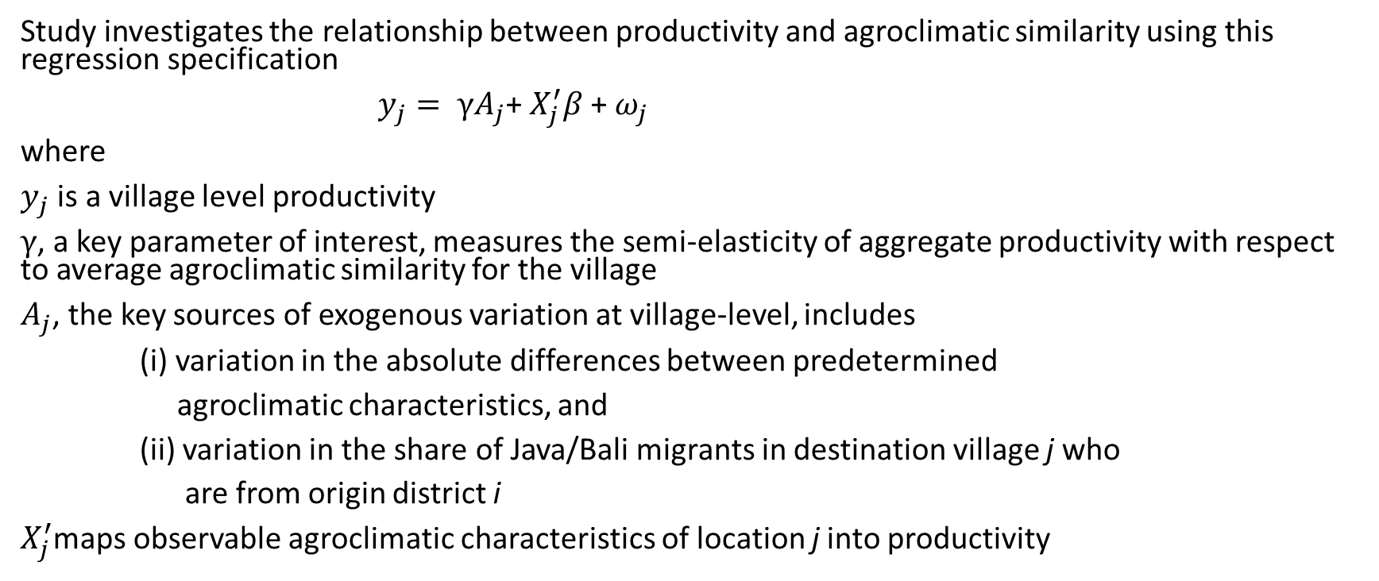
Empirical strategy
Study investigates the relationship between productivity and agroclimatic similarity using this regression specification
$y_{j}= γA_{j}$+ $X_{j}^{′}β$+ $ω_{j}$
where
$y_{j}$ is a village level productivity
$γ$, a key parameter of interest, measures the semi-elasticity of aggregate productivity with respect to average agroclimatic similarity for the village
$A_{j}$, the key sources of exogenous variation at village-level, includes
(i) variation in the absolute differences between predetermined
agroclimatic characteristics, and
(ii) variation in the share of Java/Bali migrants in destination village j who
are from origin district i
$X_{j}^{′}$maps observable agroclimatic characteristics of location j into productivity

Slide 7
Identification
Endogenous location, crop, and occupation choices could undermine the comparison of rice productivity in high and low similarity villages
To estimate skill transferability across locations in the agricultural context, one needs
(i) Randomly assign farmers from many origins to many destinations, and
(ii) Minimize selection biases due to crop and occupational choices
The exogenous relocation process assures (i)
Selection bias (ii) is minimized by
The fact that previously landless transmigrants embarked on the program with the goal of farming, and their newly acquired land tied the first generation movers to farming
Rice was grown by virtually all transmigrants prior to departure, and its pervasiveness across program villages makes it a natural focal crop

Slide 8
Identification (cont.)
Additional checks show that
Agroclimatic similarity is uncorrelated with pre-program correlates of productivity, which rules out first-order concerns about unobserved natural advantages
individuals from origin districts in the bottom quintile of potential rice productivity in inner island have significantly higher individual agroclimatic similarity than those coming from origin districts in the top quintile of potential productivity
These evidences suggests that agroclimatic similarity is balanced across Transmigration villages and is not proxying for unobservable natural advantages prevailing in inner islands

Slide 9
Data
Study focuses on 814 villages that were created under the Transmigration program
The study uses the following data sources
Digitized census of program settlements, produced by the Ministry of Transmigration to identify transmigrant villages
Harmonized World Soil Database (HWSD) to measure agroclimatic characteristics including elevation, slope, ruggedness, altitude, distance to rivers and the sea coast, rainfall, temperature, and soil texture, drainage, sodicity, acidity, and carbon content
Temperature and precipitation data from University of Delevare
The 2000 population census to identify each individual’s district of birth and his or her current village of residence
The 2002 round of triennial administrative census known as Podes (or Village Potential) to measure agricultural productivity
Various auxiliary datasets

Slide 10
Findings
The study finds that villages that were assigned a higher share of migrants from agro-climatically similar origins in inner island exhibit greater rice productivity compared to villages that were assigned migrants from less similar origins
It finds large effects for rice and moderate effects for other food crops
Findings suggest that some of the observed spatial productivity gaps may be explained by barriers to transferring skills and ultimately adjusting to new economic environments
The results have important implications for the design of future resettlement programs
Evidence from a simulation exercise suggests sizable aggregate rice productivity gains from optimally allocating migrants on the basis of agroclimatic similarity
Paper finds the largest barriers to transferability for soil-specific skills and for villages in the bottom tercile of agroclimatic similarity
It also finds that both social capital within resettlement areas and interacting with natives are important adaptation mechanisms that should be considered when resettling people to new growing environments

